Slide 1




Slide 2



Notes:
Senior
2

Slide 3
All have a common problem
How to identify the best place to live
according to their needs?
Typ!: a platform to identify the best
place to live according to users' profiles

Slide 4

All have a Common Problem
How to identity the best place to live?
The key is to build an identity card of the
neighborhood in a given area via Open Data

Slide 5

Typ! is an online application that offers a practical way to express a set of preferences to search and find the perfect area where to settle down when moving into a certain region with rules based on sustainability

Slide 6


Typ! integrates all data related to a city and a geographic area: from tree position, pollution measurements, criminal indexes, tourism, etc.
Data Integration Layer

Slide 7
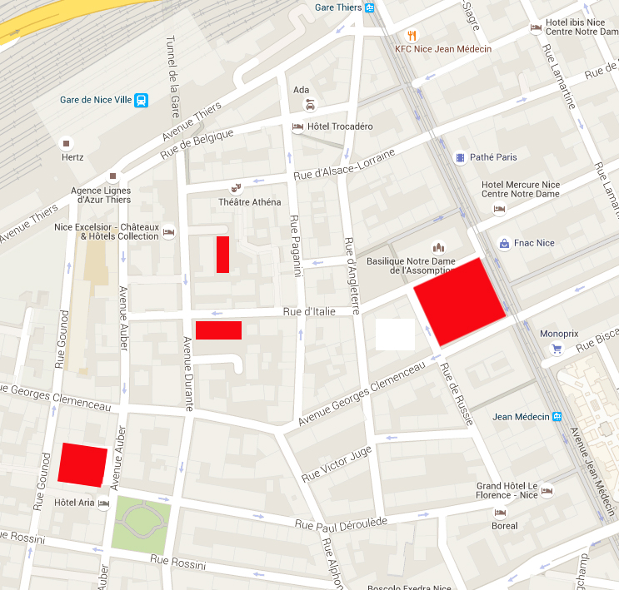
Discretize the area of interest into atoms (buildings)

Slide 8
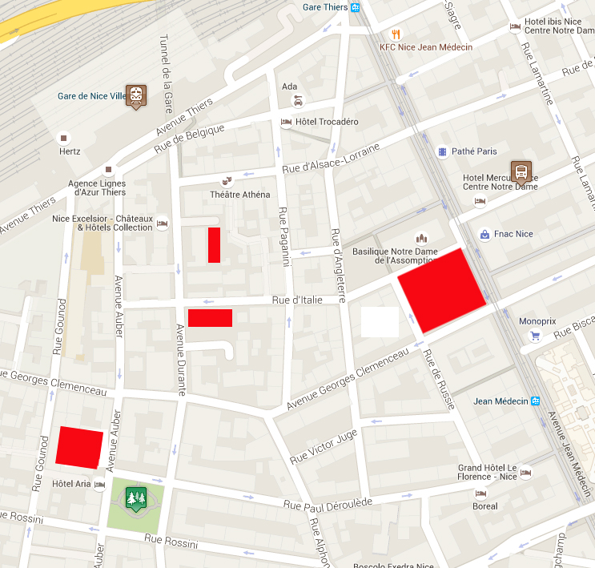

Discretize the area of interest into atoms (buildings)
Trace meaningful facilities based on users’ preferences and needs

Slide 9
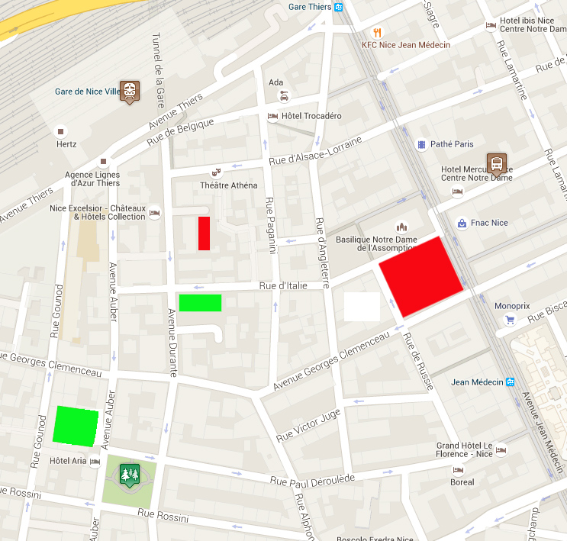
Discretize the area of interest into atoms (buildings).
Trace meaningful facilities based on users’preferences and needs.
Evaluate distances.
Aggregate distances and find the best area

Slide 10
Demo

Slide 11

Technical Limitation
Missing Data
No standard format
Data Integration
Data Query
Data Collection
No Intelligence
Information = f(Data)

Slide 12
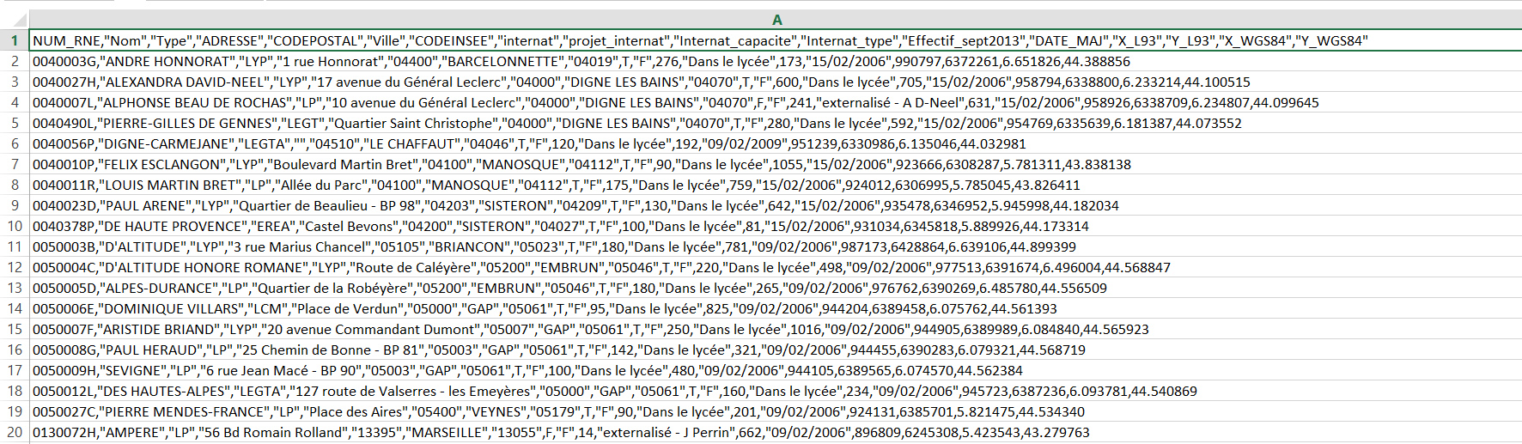
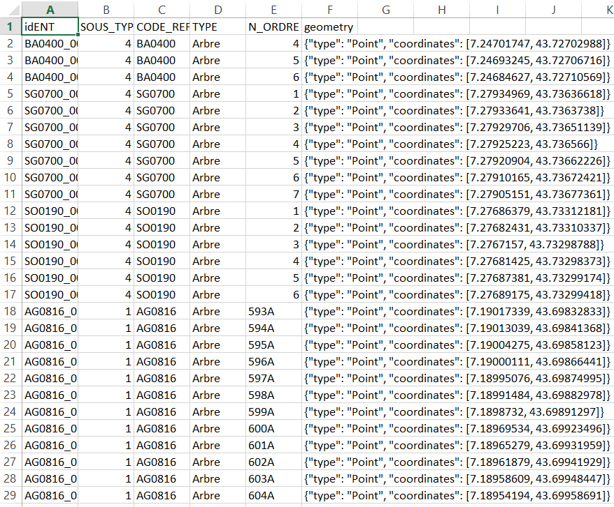
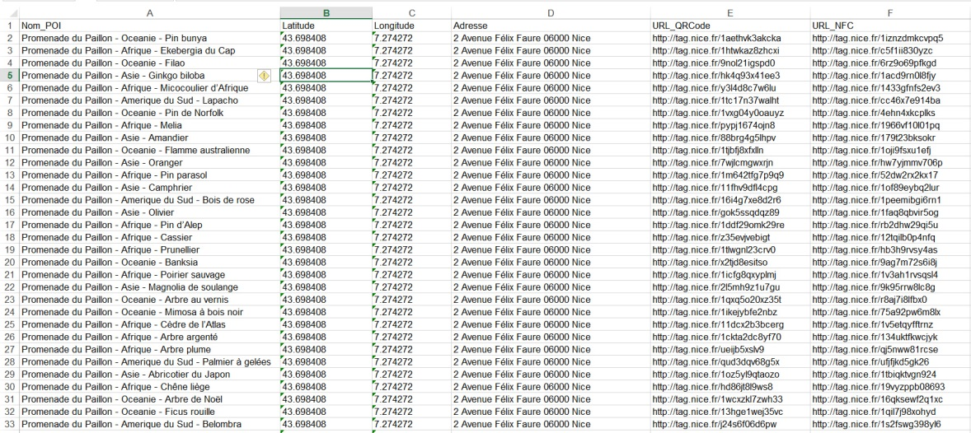

Slide 13


Slide 14



Statistics Analysis
Policy Recommendations
Knowledge Base / Semantic Search
Polished
Aggregated
Data
Data Integration Layer
Notes:
14

Slide 15

Partnerships with real estate agencies
Typ! Revenue model
Turnkey on premises deployment
Premium Subscription
Further value added services

Slide 16
SaaS (APIs or semantic engine)
ErdÖs! Revenue model
Advertisements
Partners: Public Entities, Statistic Entities
Clients: Open Data Companies

Slide 17
ErdÖs competitors
- etalab.gouv.fr : public
Typ! competitors
kelquartier.com : static, limited
Google Maps : very limited insights

Slide 18
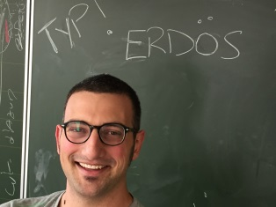
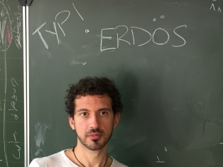
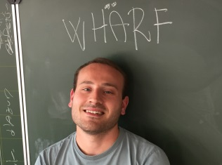
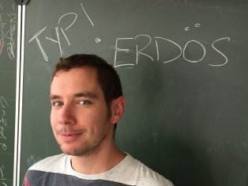
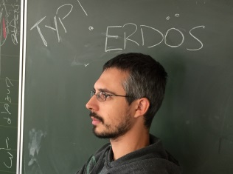
Data Modeler,
PhD Eurecom
Semantic Web Specialist,
PhD INRIA
Technology Innovation Consultant, Accenture
Distributed System,
PhD Eurecom
Mobile & Web Software Engineer, Eurecom

